Slide 1
Community Recovery: It’s a Long Haul
Community Assistance | April 2023
Notes:
(Title Slide Option 1)

Slide 2
The National Disaster Recovery Framework (NDRF)
Notes:
Before we start with an explanation of what CPCB is, it’s important to know the context of Recovery and the National Disaster Recovery Framework.

Slide 3
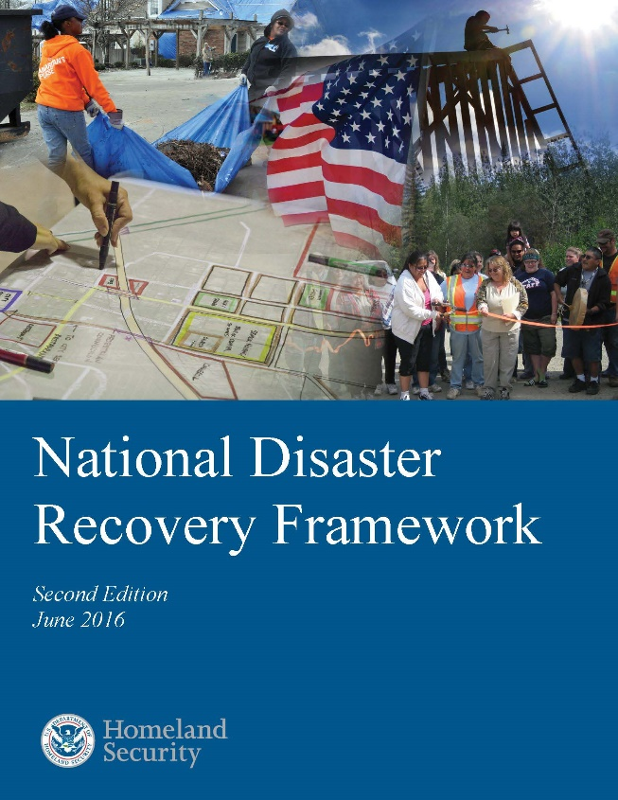
National Disaster Recovery Framework (NDRF)
Guidance to help recovery managers coordinate efforts in a unified and collaborative manner.
Provides context for how the Whole Community works together to restore, redevelop, and revitalize the community following a disaster.
National Disaster Recovery Framework
Notes:
The National Disaster Recovery Framework (NDRF) provides organizational and operational guidance for whole community engagement in disaster recovery.

Slide 4

NDRF Guiding Principles
Individual and Family Empowerment
Leadership and Local Primacy
Pre-Disaster Recovery Planning
Engaged Partnerships and Inclusiveness
Unity of Effort
Timeliness and Flexibility
Resilience and Sustainability
Psychological and Emotional Recovery
Notes:
Eight Guiding Principles
Leadership and Local Primacy: Local, state and tribal governments have primary responsibility for the recovery of their communities and play the lead role in planning for and managing all aspects of community recovery.

Slide 5
What exactly is Community Assistance?
Notes:
We’ve just explained the structures under which CPCB falls. This sets the context for what CPCB actually DOES.

Slide 6
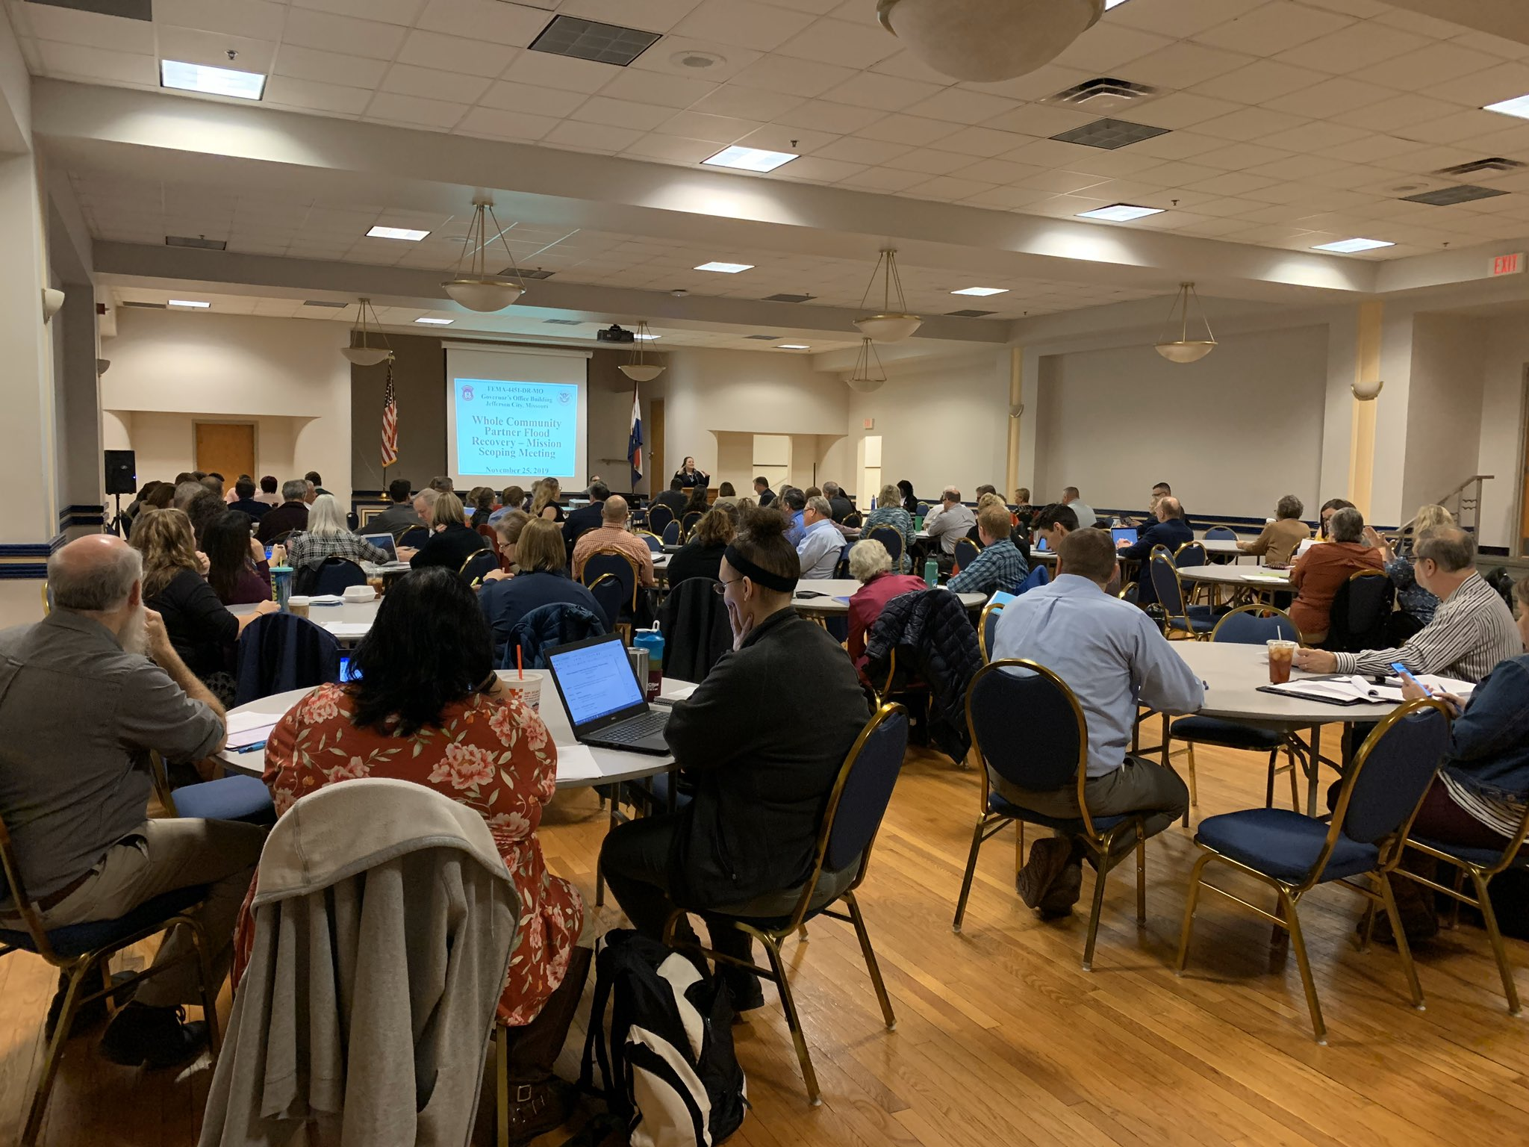
Community Assistance Recovery Support Function Mission:
“The [CA] RSF unifies and coordinates expertise and assistance programs from across the Federal Government as well as nongovernment partners to aid local and tribal governments in building their local capabilities to effectively plan for and manage recovery and engage the whole community in the recovery planning process.”
Community Assistance Recovery Support Function
Notes:
Why CPCB? OUTCOMES:
Improved local leadership capability
Improved post-event planning
Improved local involvement of community stakeholders
Improved local recovery management (LDRM)
Which lead to:
better local decisions, resilience, more community support, accountability
faster/efficient/effective recovery and use of federal dollars.

Slide 7
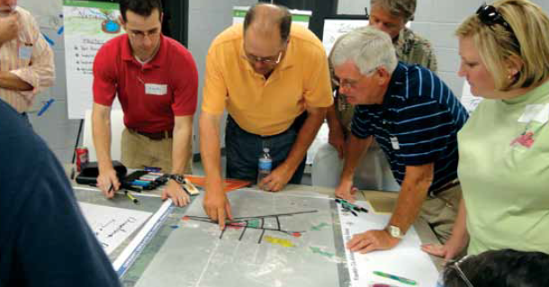
Community Assistance Pre-Disaster:
Coordinates resources for disaster recovery
Prepares federal and state partners for potential Interagency Recovery Coordination (IRC) and Community Assistance (CA) deployment post-disaster
Develops strategic partnerships
Conducts education and outreach
Notes:
Why CPCB? OUTCOMES:
Improved local leadership capability
Improved post-event planning
Improved local involvement of community stakeholders
Improved local recovery management (LDRM)
Which lead to:
better local decisions, resilience, more community support, accountability
faster/efficient/effective recovery and use of federal dollars.

Slide 8
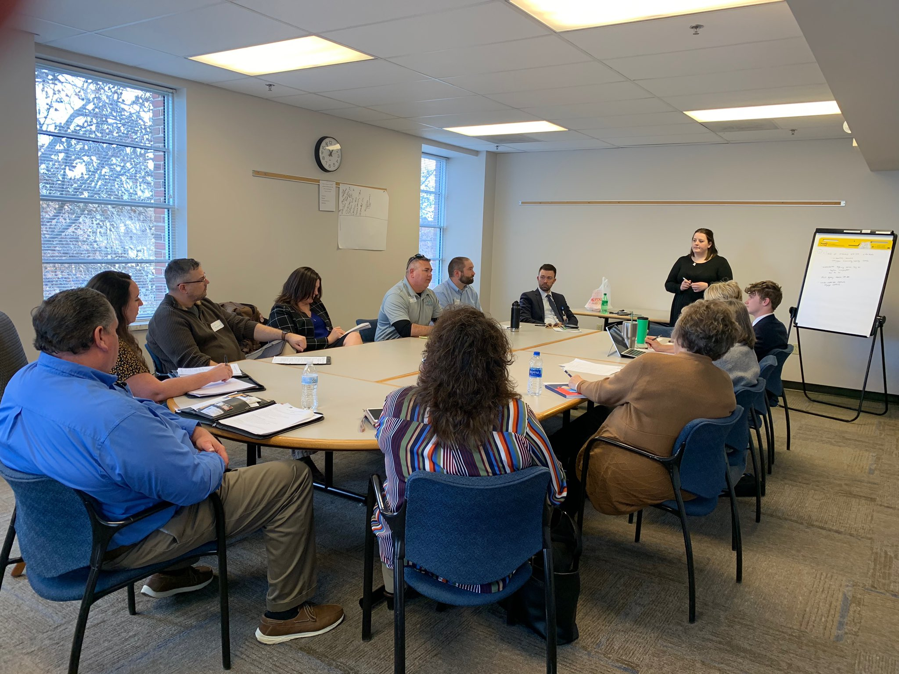
Community Assistance During a Disaster:
Directing activities tailored to the needs of the community, such as:
  Whole Community Engagement
  Information sharing
  Planning tools and guidance
  Assessment, and
  Strategy development for short-term capacity building
Notes:
Why CPCB? OUTCOMES:
Improved local leadership capability
Improved post-event planning
Improved local involvement of community stakeholders
Improved local recovery management (LDRM)
Which lead to:
better local decisions, resilience, more community support, accountability
faster/efficient/effective recovery and use of federal dollars.

Slide 9
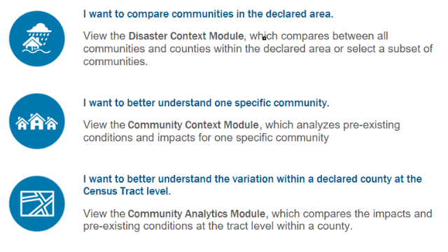
Community Analysis Tool

Slide 10
Community Assistance Post-Disaster:
Supports partners by providing resources:
  Education
  Peer-to-peer-forums and workshops
  Community engagement and partnership development
  Information on non-Stafford Act funding and technical assistance
Notes:
Why CPCB? OUTCOMES:
Improved local leadership capability
Improved post-event planning
Improved local involvement of community stakeholders
Improved local recovery management (LDRM)
Which lead to:
better local decisions, resilience, more community support, accountability
faster/efficient/effective recovery and use of federal dollars.

Slide 11
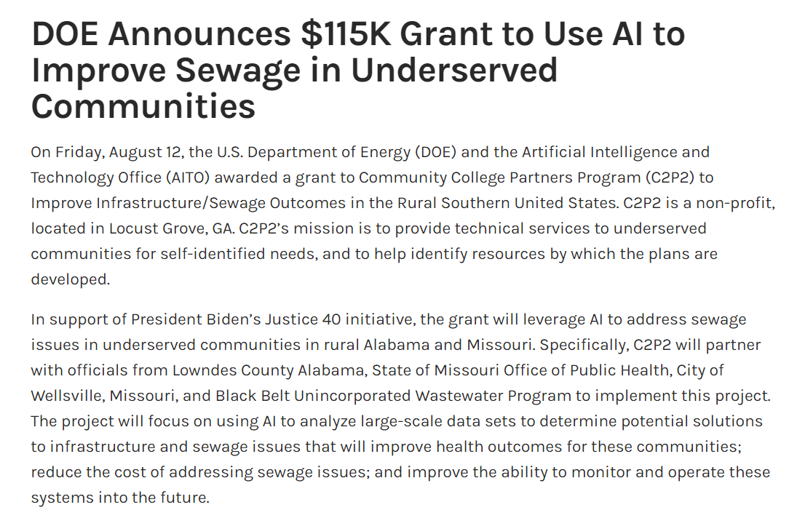
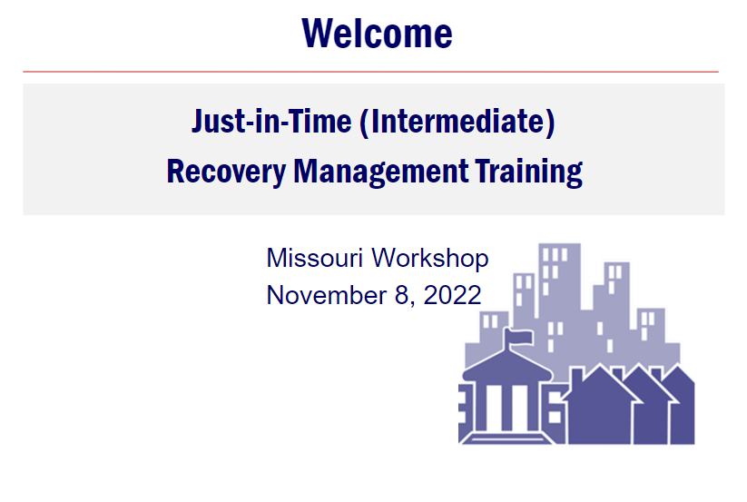
Recent Community Assistance Examples:
Department of Energy
Resources for Communities | Recovery.mo.gov
Notes:
Why CPCB? OUTCOMES:
Improved local leadership capability
Improved post-event planning
Improved local involvement of community stakeholders
Improved local recovery management (LDRM)
Which lead to:
better local decisions, resilience, more community support, accountability
faster/efficient/effective recovery and use of federal dollars.

Slide 12
Just-In-Time Training Delivery Options
In-person courses (8 hours):
  Immediate: 0 to 2 months post disaster
  Intermediate: 3 to 5 months post disaster
  Long-Term: 6+ months post disaster
Peer-to-Peer Virtual & Panel Workshops (2 hour panel + Q&A)
Peer-to-Peer Instructors
Peer-to-Peer Individual Advisor

Slide 13
Questions?
Jessica Catron Pugh
Community Assistance RSF Coordinator
Jessica.Pugh@fema.dhs.gov
(202) 368 - 1699

