Slide 1

Components of an Effective Incident Response Plan
Missouri Office of Homeland Security Cybersecurity Specialist Angie Robinson

Slide 2
Disclaimer
All information in this presentation and talked about today is advice and suggestion based only. There is no legal liability on MO DPS or MO OHS or MO Fusion Centers.
Most of the information discussed today has been learned from previous stakeholders.

Slide 3


Introduction
Missouri Department of Public Safety
Missouri Office of Homeland Security
Missouri Information Analysis Center
Cybersecurity Specialist

Slide 4


Fusion Centers
Notes:
80 DHS recognized in US
Created after 9/11 – Cyber is a Homeland Security Problem not just an IT problem
3 in Missouri
Cyber program coordinates with all 3 to have a cohesive Missouri Message
STLFC
MIAC
KCRFC

Slide 5
MO OHS/MIAC Cybersecurity Program
Train
Be Aware
Plan
Exercise
Share

Slide 6
Outreach
Cyber Training
Tabletops
Incident Response Workshops
Cyber Intelligence Partners (CIP) Program
Train

Slide 7
MO OHS/MIAC Cybersecurity Program
Train
Be Aware
Plan
Exercise
Share

Slide 8

Weekly Cybersecurity Open Source Intelligence Wrap Up
Vulnerability notification
Gathering and processing cyber intelligence
OSINT gathering (including dark web)
Indicators of Compromise (IOC) research
Requests for information
Developing and disseminating cyber intelligence products
Notes:
To receive any of our intelligence products please refer to the Cybersecurity Distribution List section on our Cybersecurity Flyer.

Slide 9
MO OHS/MIAC Cybersecurity Program
Train
Be Aware
Plan
Exercise
Share

Slide 10

Notes:
This brings us to the Incident Response Plan – what we are here to talk about today.
First let’s go over some considerations to prepare for your incident response plan.

Slide 11


Considerations -
Insurance
Notes:
Do you have Cybersecurity Insurance?
Does your policy specify having an incident response plan to be covered?
If so, what is specified in your policy to be included in your plan?
Things to look for in your policy:
Can you talk to LE/Federal Agencies? Why you should contact LE and Feds – keys….
At what point during an incident do you have to contact your insurance?
If it is a ransomware attack, what is in your policy as far as ransom?
Depending on the attack and your policy your insurance company may take care of a lot of what we will talk about today. This is why it is important to communicate with your insurance provider….however, remember, having insurance is not your IR plan.

Slide 12
Considerations –
Assessments
  CISA
  CISA CSET Tool
  MS-ISAC National Cybersecurity Review
  Third Party Assessments
Notes:
Assessments will help to identify your gaps in your cybersecurity hygiene.
Once those gaps have been mitigated, this will help to increase your cybersecurity hygiene.
Knowing your gaps and what has been mitigated will help during the IR plan writing process.
When was the last time you had an assessment?
Do you have an assesment schedule?

Slide 13
Considerations - Policies/Training
Information Logging
Internet Usage
Mobile Device Encryption
Password Construction
Remote Access
Removable Media
Router and Switch Security
Server Audit
Malware protection
Social Engineering Awareness
Software installation
Equipment Disposal
VPN
Wireless Communication
Workstation Security
More….
Acceptable
  Encryption
  Use
Bluetooth
Clean Desk
Data Breach
Email/Email Retention
2FA/MFA
Notes:
End user training?
Policies will help to determine what the normal is while writing your IR plan.

Slide 14
Considerations –
Who should be included?
Information Technology (IT) team
Security Team
Crisis Management Team
Legal Counsel/Legal Advisor/Legal Team
Public Relations
Management
Technology Services Providers (TSPs)
More…

Slide 15
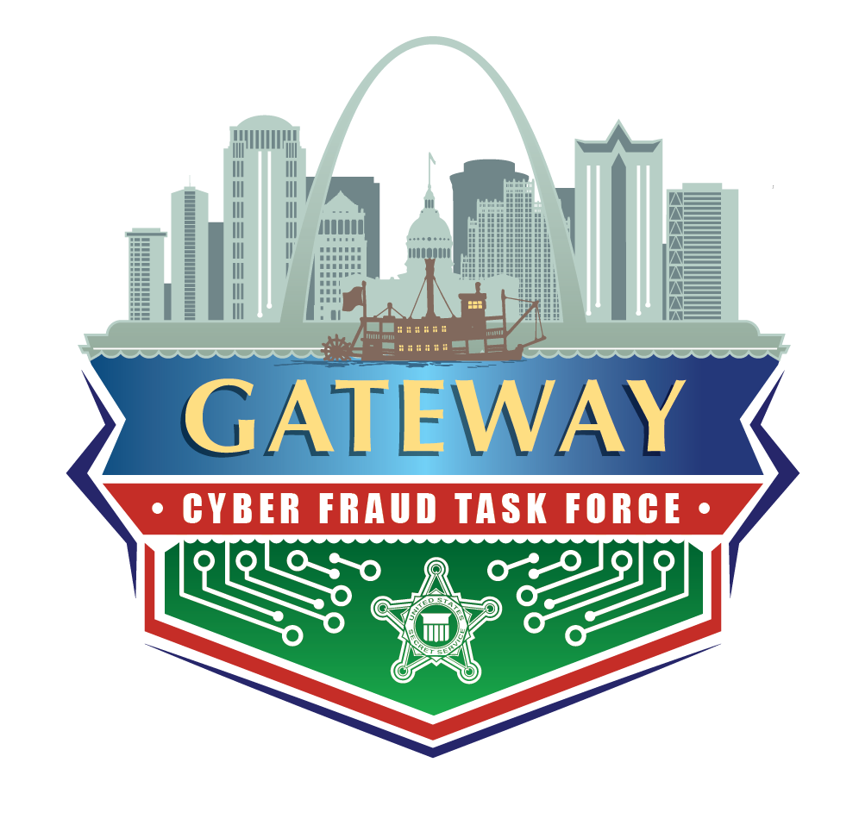





Resources
Notes:
Know your resources and what they can do for you and write them into your IR plan.
Reach out early and often – make connections – don’t wait until something happens

Slide 16

Where do you start?
Templates
  SANS: https://www.sans.org/information-security-policy/?page=3
  CISA CSET Tool: https://www.cisa.gov/stopransomware/cyber-security-evaluation-tool-csetr
Notes:
How many of you have incident response plans?
How many of you have IR plans and have looked at them in the past 6 months?
How many have exercised those plans?
And how many of you have updated the plan after your exercise?
For those of you that do have plans was the hardest part figuring out where to start?
For those of you that don’t have plans is this what is holding you up?

Slide 17
Elements of Your Incident Response Plan - Contacts
Ransom Note Found – Machine Not Working
Who gets the first call? Supervisor? IT?
Who is the next call? Create a call down list
When do you contact LE/Federal Agencies?
When do you contact insurance?

Slide 18
Elements of Your Incident Response Plan –
You will need…
Definition of Event vs Incident
Note Taker
Chain of Custody Standard/Policy
Communication Log
How will you contain the attack?
Forensics
How will you restore?
How will you know when the threat has been mitigated and completely out of your system?
Notes:
Chain of Custody Standard/Policy (Instructions – who will do it, how it will be logged, who touched what?)
How will you restore? Back ups? Forensics on back ups to determine when/if the backups were compromised and find when to restore from.

Slide 19
Elements of Your Incident Response Plan – Public Relations
Include your PR people in the IR plan writing process
Pre-written publications for a cyber attack to initially post/disseminate – vague
Have management and IT/Cybersecurity professionals coordinate writing additional publications

Slide 20
MO OHS/MIAC Cybersecurity Program
Train
Be Aware
Plan
Exercise
Share

Slide 21


Get everyone to the table
Don’t rush!
Walk through the entire scenario with your IR Plan
Find the gaps….discuss how to fill them
Revise the plan.
Notes:
A plan on a shelf is no use!
The more you exercise the plan the more everyone learns their roles and responsibilities.
You want this to become second nature
The more you exercise the more gaps are filled, the better your cyber hygiene
Your network does not stay the same and neither should your plan, it should update with new vendors, software, policies, and training.

Slide 22
MO OHS/MIAC Cybersecurity Program
Train
Be Aware
Plan
Exercise
Share

Slide 23

Information sharing
Helps others
Helps you
Anonymize

Slide 24
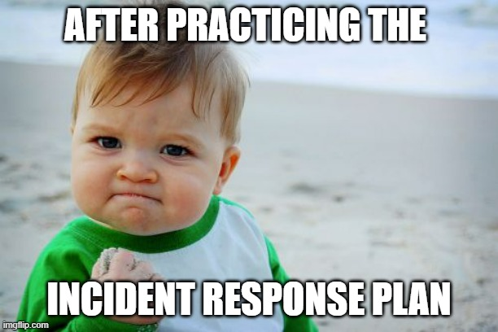
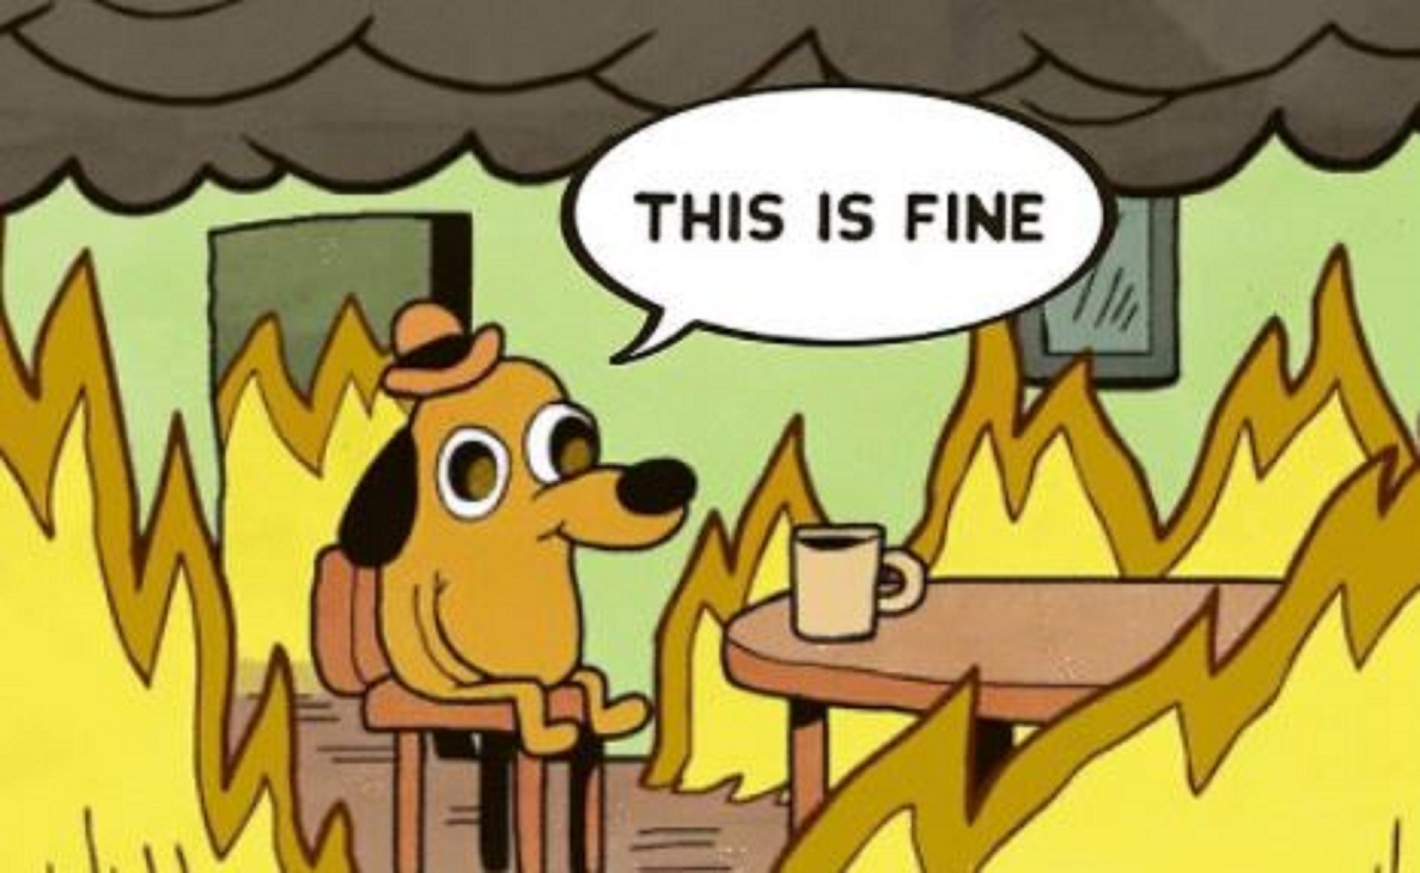
Thank YOU!
Angie Robinson
Cybersecurity Specialist
Missouri Office of Homeland Security
Missouri Information Analysis Center
Missouri Department of Public Safety
Angela.Robinson@mshp.dps.mo.gov
Cyber Line: 573-526-0153
Desk: 573-751-9000 x4262
Cell: 573-301-2023
MO OHS Cybersecurity Unit
573-526-0153
securityintel@mshp.dps.mo.gov

