Slide 1
DR-4665-MO HSS RSF Mission Assignment
Sara Shirk, MSW and Steve Bollin, MPA
DR-4665-MO MA Strategy and Process Updates Meeting
19 July 2023
Notes:
Welcome to the new ASPR PowerPoint template. Each slide contains helpful information for making the entire presentation user-friendly and accessible to people of all abilities. Please play specific attention to the Notes section for each slide for more detailed information on adhering to ASPR PowerPoint design requirements.
To begin development of your presentation, simply begin typing directly on each slide within this template. Right click on each slide and choose Duplicate Slide to use the same slide template for another slide. Choose Delete Slide if the slide template is not needed.
This presentation is formatted to include the classification of “Unclassified.” To change the classification to “Unclassified//For Official Use Only, “Confidential,” or “Secret” select the View tab above then Slide Master. You must change the classification on each template slide. Once all slides are updated with the new classification, click on Close Master View.
Note that the title slide should display the overall classification of the entire briefing. For example, if the brief consisted of three Unclassified slides, one Unclassified//For Official Use Only, and one Confidential slide, the overall classification of the entire briefing would be Confidential, since that is the highest level of classification in the brief. The classification “Confidential” would be listed on the title slide.
Definitions of classifications:
Unclassified: This slide set can be distributed widely to all target audiences, including the general public. This slide set can also be posted to the meeting sponsor’s website.
Unclassified/For Official Use Only: This slide set is for limited distribution only. Although the information presented is unclassified, it may not be appropriate for public release. Often these slides contain information from documents or results from studies that are in draft form and have not been cleared for public use.
Confidential: This slide set includes information of which reasonably could be expected to cause damage to the national security.
Secret: This slide set includes information of which reasonably could be expected to cause serious damage to the national security. Secret classification is reserved for such things as government programs safeguarding nuclear materials; developing, production, or use of weapons of mass destruction; foreign relations/activities of the US., including confidential sources, etc. We do not expect many, if any, ASPR presentations to be classified at the Secret level.

Slide 2
ASPR DCMR
ASPR’s Division of Community Mitigation & Recovery (DCMR) contains the programmatic and operational activities to conduct field and HQ operations for activations of the Health and Social Services Recovery Support Functions or recovery mission taskings from the ASPR or the HHS Secretary.
DCMR provides technical assistance that guides local and state agencies in the identification of specific barriers to recovery, including the addressing of Behavioral Health needs of the impacted population with identified core mission areas vital to recovery for communities and citizens.
Notes:
Your slides are preformatted. It’s not necessary for you to change the colors or the list labels (bullets and numbers). ASPR templates use two primary colors for the text: dark blue for the header and black for body text. Brown or red text can be used sparingly to draw attention to a key word, phrase, or number. Additional colors are available to create charts and tables, including light blue, green, and purple. All colors must be selected from the ASPR Branded Color Template. This template is accessible on the top ribbon of each page just to the left of the title presentation. It is also pre-selected as the color theme.

Slide 3
MO HSS Recovery Team: Members
Steve Bollin, MPA, Director
Division of Regulation & Licensure, Missouri Dept. of Health and Senior Services (DHSS)
MO HSS Recovery Support Function (RSF) Lead
Sara Shirk, R7 Recovery Coordinator
HHS/ASPR Division of Community Mitigation and Recovery (DCMR)
Region 7 (IA, KS, MO, NE & 9 Federally Recognized Sovereign Tribes)
Scott Dugas, Team Lead for R1, R7, and R9
HHS/ASPR Division of Community Mitigation and Recovery (DCMR)
Brenda Bell-White, HSS RSF Liaison
FEMA Interagency Recovery Coordination (IRC)
DR-4665-MO

Slide 4
MO HSS Recovery Team: DR-4665-MO
SEMA requested assistance and recommended the activation of the HSS Recovery Support Function (RSF)
This is led by Missouri’s DHSS and federally supported by ASPR DCMR
HSS contains the programmatic and operational activities to conduct field and recovery help during activations
HSS provides technical assistance and working with states, local entities, and others in the identification of specific barriers to recovery within core mission areas vital to recovery for communities
HSS works alongside state and local entities to develop courses of action for capacity building of HSS systems
Notes:
Sara

Slide 5
Health & Social Services RSF Supporting Equitable Recovery
Mission: Assist locally-led recovery efforts in the equitable restoration of the public health, healthcare and social services networks to promote the resilience, health and well-being of affected individuals and communities along the following five (5) Core Mission Areas & four (4) Cross-Cutting Principles.
Notes:
To fulfill its Core Functions and Capabilities, the HSS RSF focuses on nine Core Mission Areas. These are: public health, health care service impacts, environmental health impacts, behavioral health impacts, food safety and regulated medical products, social service impacts, referral to social services / disaster case management, long-term recovery impacts to first responders, and children in disasters (including schools, children, and youth).
The following slides will examine, in detail, the sub-tasks involved in each of these Core Mission Areas.

Slide 6
HSS Considerations
Whether there is a need for creation of organizations or processes to address HSS needs.
Areas where HSS are impacted (e.g., access to care, healthcare facilities, schools, childcare, etc.).
Diminished capacity/access or displacement of healthcare, public health, or social services infrastructure or delivery systems or providers.
Elevated air/water environmental health risks and/or food safety risks.
Disaster-caused impacts or impairments to HSS provided to children, youth, and schools.
Prolonged disaster impacts to school facilities and/or educational environment.
Notes:
Scott

Slide 7
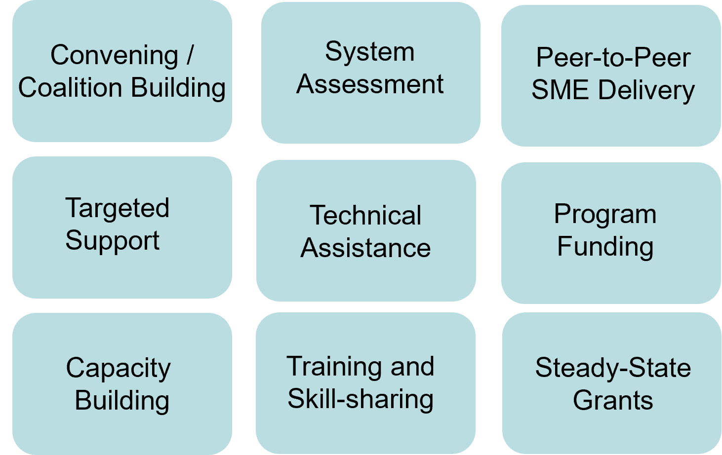
Levers of HSS Recovery
Funding, both Programmatic & Supplemental
Subject-Matter Expertise
Notes:
Sara & Scott
Goal is to build coalitions to leverage program funding and programmatic expertise to build capacity

Slide 8
DR-4665-MO St. Charles County, St. Louis County, and the City of St. Louis
July 2022 Flooding – Recovery Needs Strategy:
The HSS RNA and Recovery Strategy Development (RSD) / COA’s includes coordinating with the Missouri HSS RSF Lead to gather local HSS post-disaster concerns.
The Missouri HSS RSF Lead with the Department of Health and Senior Services (DHHS), FEMA liaison, and federal HHS ASPR recovery will be visiting localities to conduct recovery listening sessions.
Understanding pre- and post-disaster system gaps and needs will support the development of potential courses of action (COA’s) for local HSS recovery planning.
Systems include health care systems, public health/environmental health, behavioral health, social services, and education. Listening sessions will be held with persons who have specific knowledge of gaps and needs in identified program areas.

Slide 9
DR-4665-MO HSS RNA Strategy
State Partner Strategy Meetings
Local Jurisdiction Listening Sessions
Collating Data
The HSS RNA, RSD Report, & COA’s
Local Engagement Process

Slide 10
Local Engagement Process
Development and execution of process for engagement and standardized outreach and engagement materials.
Strategy Document Development
Template communication to State and Local Jurisdictions
Listening Session Facilitation Materials
Issue Tracking Documentation

Slide 11
State Partner Strategy Meetings
Engagement with state leaders within the HSS core areas and provide an orientation to the RNA and RSD process for the Locality Listening Sessions.
Building Listening Session Strategies
Developing Partnerships
Mission and Scope
Building Consensus

Slide 12
Local Jurisdiction Listening Sessions
The information provided from State Recovery Strategy Meetings will drive local listening sessions that will be facilitated through a root cause analysis format.
Meeting with Local Jurisdictions
St. Charles County
St. Louis County
Core Focus Areas
Behavioral Health
Environmental Health
Identifying Issues
City of St. Louis, MO
Public Health
Social Services
Education / Children
Program Staff
Systemic Concerns
Community Needs
Other Disaster Complexities

Slide 13
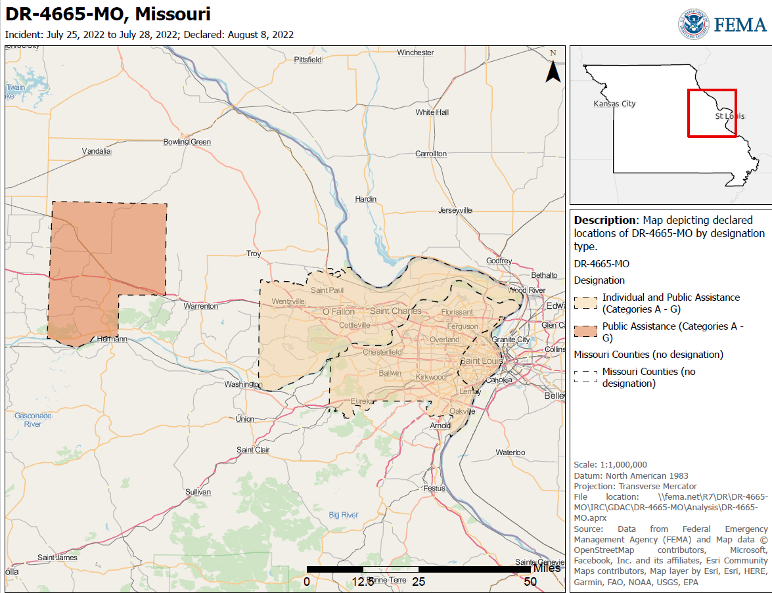
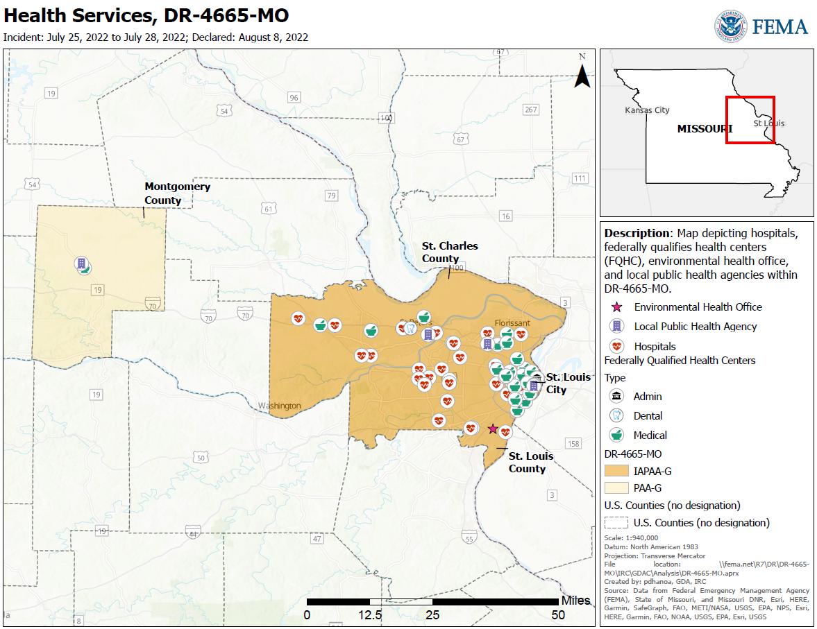
Collating Data
Issues identified through listening sessions or other avenues will be collated in the MAX-TRAX HSS RNA Dashboard.

Slide 14
The HSS RNA, RSD Report, & COA’s
RNA:
RSD:
Identified needs from local jurisdiction HSS programs
COA’s:
Leverage federal, state, and local SMEs
Identified needs from federal and state partners
Next Steps: Meeting with Local Jurisdictions
Potential COA’s to be discussed with State and Local partners
Build out specific projects for to meet the goals of the communities
Work with SMEs to identify potential COA’s that address the root of local recovery needs, which could include TA, training, funding, and other types of solutions.

Slide 15
Find Us Online
On the Web:
aspr.hhs.gov
Facebook:
facebook.com/ASPRgov
Twitter:
twitter.com/ASPRgov
Twitter: Dawn O’Connell
twitter.com/HHS_ASPR
Instagram:
instagram.com/ASPRgov/
YouTube::
youtube.com/c/ASPRgov
Flickr:
flickr.com/ASPRgov
Sara Shirk
Sara.Shirk@hhs.gov
LinkedIn:
linkedin.com/showcase/hhs-aspr/
Notes:
Slide 23 | Contact Us

Slide 16
Disclaimer
The views, opinions, and/or findings expressed are those of the author and should not be interpreted as representing the official views or policies of the U.S. Department of Health and Human Services or the U.S. Government.
Notes:
Sample disclosure slide.
Include disclosure slide after the title presentation slide if the federal government is not paying for the presenter’s time to give the presentation or if the presentation does not represent a policy or position of HHS/ASPR.
Disclaimer statement: “The views, opinions, and/or findings expressed are those of the author and should not be interpreted as representing the official views or policies of the U.S. Department of Health and Human Services or the U.S. government.”
Do not include the disclaimer statement if the federal government is paying for the presenter’s time to give the presentation, and/or if the presentation describes a policy or position of HHS/ASPR.

