Slide 1
MISSOURI DEPARTMENT OF LABOR & INDUSTRIAL RELATIONS
Jerry Duvall, Program Coordinator
Division of Employment Security

Slide 2
DISASTER UNEMPLOYMENT ASSISTANCE (DUA)
Background:
The Great Depression started with the stock market crash of 1929.
Unemployment spiked to 25%.
Missouri’s current unemployment rate is approx. 2.5%.
In response, the Social Security Act (SSA) of 1935 was enacted which originally provided general welfare benefits for the elderly, disabled, and dependent children.
Title III of the SSA provided for the establishment of unemployment benefits in the U.S.
On August 17, 1936, Neils Ruud of Madison, Wisconsin, received the first unemployment check in the amount of $15.

Slide 3
In November of 1988, the Robert T. Stafford Disaster Relief and Emergency Assistance Act (Stafford Act) authorized what we currently refer to as DUA.
DUA provides temporary benefits to eligible workers and eligible self-employed individuals who become unemployed as a direct result of a major disaster.
Direct result means an immediate result of the major disaster itself, and not the result of a longer chain of events caused or worsened by the disaster.
Even though both regular unemployment and DUA are authorized by the Federal Government, they are administered by states, and certain state unemployment laws apply to DUA.
DUA is different from regular unemployment since the program coordinates with FEMA, SEMA, USDOL, and the state unemployment agency, which in Missouri is the Division of Employment Security (DES) under the Department of Labor and Industrial Relations (DOLIR).

Slide 4
Activating DUA:
The Governor of the affected state requests federal assistance detailing the severity of the disaster.
The President will issue a disaster declaration if the Governor’s request is approved.
The disaster declaration could include public assistance or individual assistance.
If the declaration includes individual assistance, DUA is triggered.
FEMA notifies USDOL, USDOL notifies the state, and the state implements DUA.

Slide 5
Implementing DUA:
Missouri prepares and issues a Press Release announcing the availability of DUA for eligible individuals.
Individuals can then file a DUA application immediately after filing an application for regular unemployment.
Individuals are advised to:
Submit weekly request for payment for each week they are directly affected by the disaster; and
Provide documentation substantiating employment and/or self-employment and wages/income earned within 21 days from the date the initial DUA application is filed.
The claim is reviewed to make sure the individual meets all eligibility requirements.

Slide 6
DUA Eligibility & Qualifications:
An individual is eligible for DUA if:
They become partially or totally unemployed due to the disaster.
Their employment or self-employment that was affected by the disaster was the individual’s principal source of income or livelihood.
The DUA Weekly Assistance amount is the same as it would have been on regular unemployment with a couple of exceptions:
The base period wages used in the calculation is the most recent tax year.
If the individual does not have sufficient earnings/wages then they will still qualify for the minimum weekly benefit amount.
Currently, the weekly benefit amount for a DUA claimant in Missouri would be between $139 and $320.

Slide 7
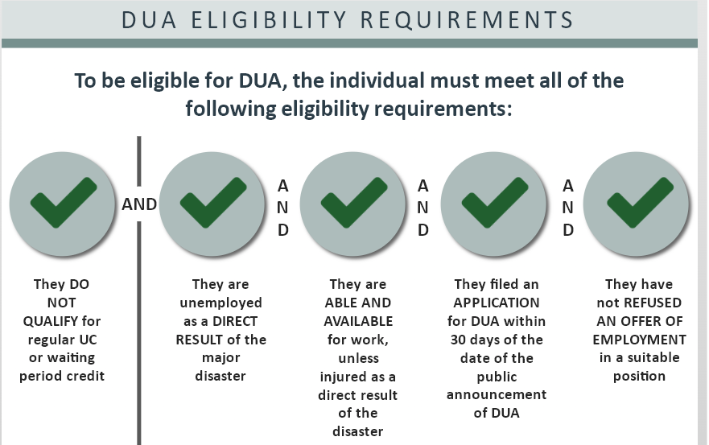

Slide 8
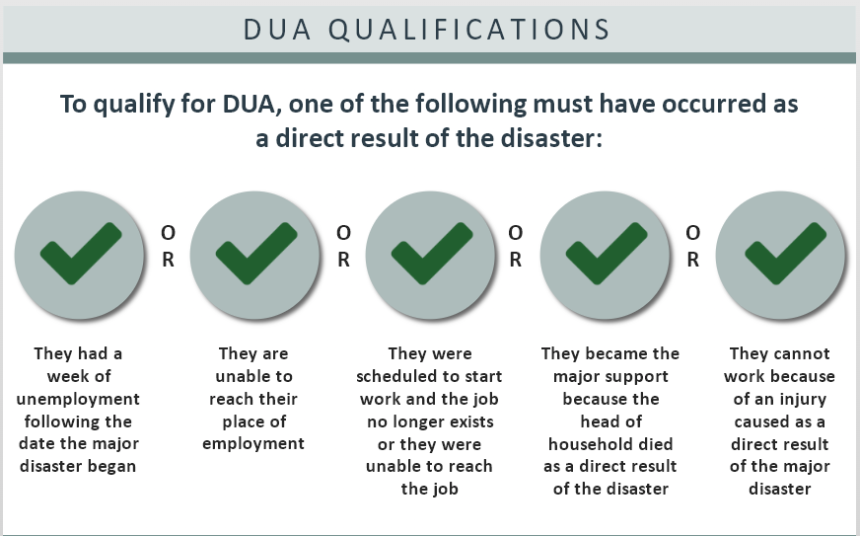

Slide 9
Terminating DUA Benefits:
An individual’s DUA benefits will be terminated for the following reasons:
The individual becomes employed or returns to their previous job.
The individual is able to resume their customary pre-disaster self-employment activities.
The individual remains unemployed after the disaster assistance period ends (usually 26 weeks).
The individual’s unemployment is no longer a direct result of the disaster. For example, the individuals returns to their job but becomes unemployed again for some other reason.

Slide 10
DUA in Missouri:
The Missouri DUA program can start taking applications with a few keystrokes.
Missouri’s modernized computer system has the ability to accept information from all types of workers and allows individuals to upload any required documentation.
The application process is entirely self-serve and is available 24/7; however, Missouri also has trained staff available to take applications over the phone and is prepared to utilize additional internal and external staff.

Slide 11
Those affected by the disaster will likely have more immediate needs than unemployment, but if necessary, Missouri DUA is prepared to respond on-site and can even take an individual’s information using pen and paper.
This was done with the Joplin tornado in 2011, the largest Missouri disaster since the floods of 1993.
Missouri also has a reciprocal agreement with other states which provides that staff from the other states can assist with processing applications in cases of a large-scale disaster.
During Hurricane Katrina, Missouri helped by sending staff to Mississippi to assist with DUA claims.

