Slide 1
ELECTED OFFICIAL’S GUIDE
to Emergency Management
Thursday, July 20, 2023
12:30pm – 1:15pm
Adam Stanek
Lincoln County Emergency Management Director
astanek@lcmoema.com
Quentin Laws
Lincoln County Emergency Management
Deputy Director
qlaws@lcmoema.com

Slide 2
LINCOLN COUNTY EMERGENCY MANAGEMENT

Slide 3
LINCOLN COUNTY EMERGENCY MANAGEMENT
Update Branding
Public Outreach

Slide 4
ELECTED OFFICIAL’S GUIDE
to Emergency Management

Slide 6
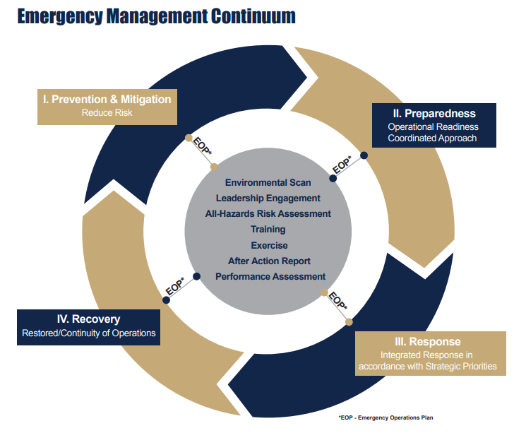

Slide 7
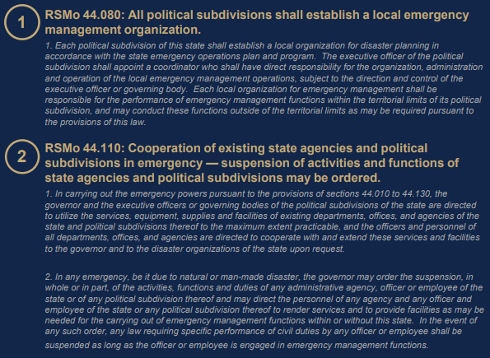
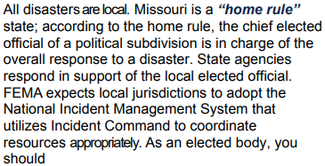
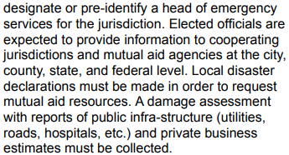

Slide 8
ELECTED OFFICIAL’S GUIDE
to Emergency Management
Individual Assistance
Public Assistance
Small Business Administration Disaster (SBA) Loan Program
Missouri Disaster Fund

Slide 9
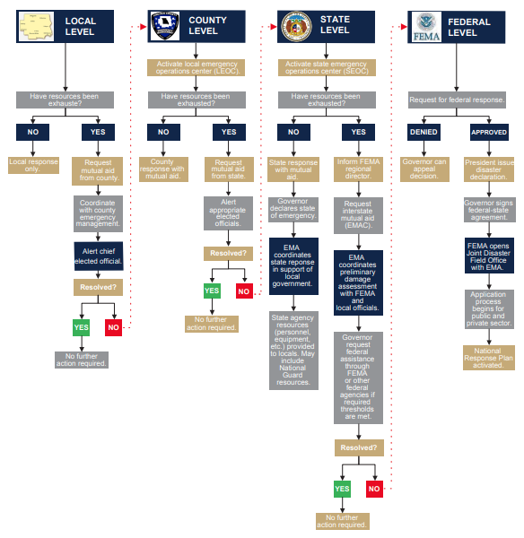
Most Important Page in the Elected Official’s Guide

Slide 11
Available Communication
Incident Size-Up
Begin personal log documentation
Request Mutual-Aid from neighboring jurisdictions
Contact County Emergency Management
Remind staff to keep complete logs of actions and financial records
Begin liaison with other officials
Remember that your role is policy-making, not operational
Contact legal advisors
Review legal responsibilities and authorities
Monitor equity of service based on needs and risks
Use elected officials to request assistance from public and private organizations

Slide 12
BUILDING RESILIENT COMMUNITIES THROUGH PARTNERSHIPS
ELECTED OFFICIAL’S GUIDE
to Emergency Management
Thursday, July 20, 2023
12:30pm – 1:15pm
Adam Stanek
Lincoln County Emergency Management Director
astanek@lcmoema.com
Quentin Laws
Lincoln County Emergency Management
Deputy Director
qlaws@lcmoema.com

