Slide 1
A Flexible Layoff Alternative for Missouri Employers
Shelby Hunsaker
Shared Work Outreach
Division of Employment Security

Slide 2


Shared Work Program
Flexibility in workforce needs
Federally authorized and state administered
Short-Term Compensation (STC)

Slide 3

History
26 states have active STC plans
Active in MO since 1987
Leader in STC plans

Slide 4

Eligibility
Any industry may participate
Employers current on all tax payments
Employers have no outstanding contribution and wage reports

Slide 5

Enrollment
Apply online through Uinteract
Once approved, email sent with step-by-step instructions
Assigned Shared Work Specialist

Slide 6
Shared Work Plan Requirements
20-40% reduction in normal work hours for employees in the plan
An affected unit of three or more employees
Application to at least 10% of the affected unit
Assurance that benefits will be administered as usual
Certification that plan is in lieu of layoffs
Advance notice to employees

Slide 7
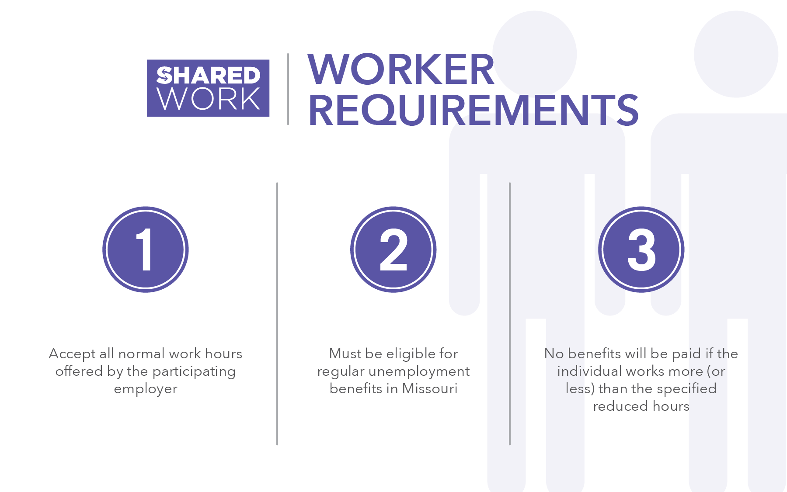
Notes:
For the worker to qualify, all they need to do is accept and be available for their normal hours and be eligible for UI benefits in Missouri, that’s it. Everything is taken care of on the employer side so confusion is minimal.

Slide 8
Plan Flexibility Based on Business Needs
Employer responsible for filing claims as needed
Use as many weeks as needed throughout the plan year
Decide which employees and units will be affected
Can adjust employee work schedules each week

Slide 9
EXAMPLE

Slide 10
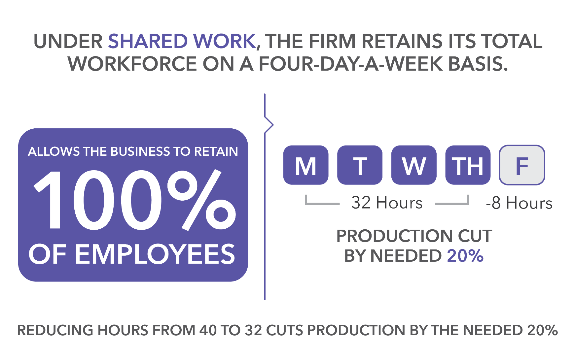

Slide 11
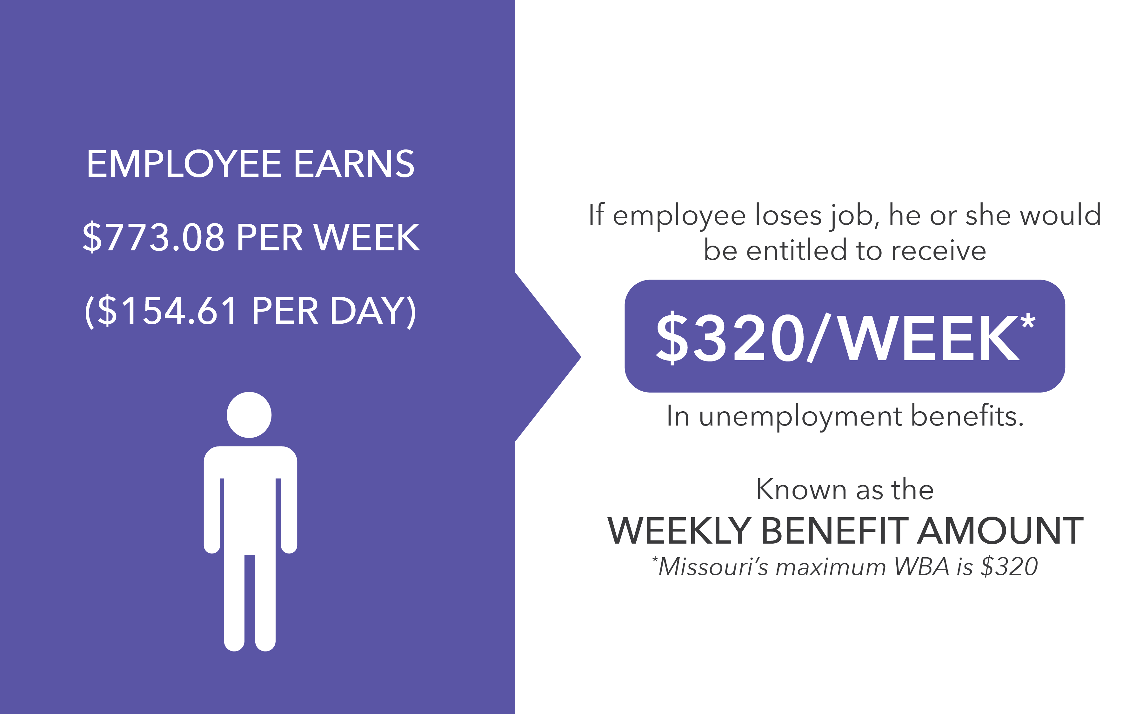
Notes:
Now under Shared Work an employee’s hours and pay can be cut between 20 and 40% but we’ll keep with our example of 20% here.
If an employee’s hours were cut 20%, here’s how it would work for them. The employee would not only continue to receive their benefits but they would receive 4 days of regular pay + 20% of their unemployment since their hours were cut 20%. Receiving 20% of their unemployment for the week equals roughly a third of the average person’s daily salary.
So getting your benefits and 4 and roughly a third of a day’s pay is not five days of pay but it’s a lot better than trying to live and budget on $320/week.
[Note: This would be an employee earning roughly $40,000 a year. His regular earnings for 4 days would be $618.46 + shared work of $64 for $682.46 vs regular $773.08. ($90.62 diff/short)]

Slide 12
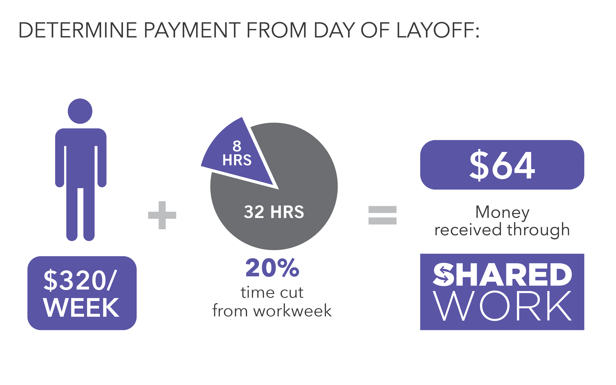
Notes:
Now under Shared Work an employee’s hours and pay can be cut between 20 and 40% but we’ll keep with our example of 20% here.
If an employee’s hours were cut 20%, here’s how it would work for them. The employee would not only continue to receive their benefits but they would receive 4 days of regular pay + 20% of their unemployment since their hours were cut 20%. Receiving 20% of their unemployment for the week equals roughly a third of the average person’s daily salary.
So getting your benefits and 4 and roughly a third of a day’s pay is not five days of pay but it’s a lot better than trying to live and budget on $320/week.
[Note: This would be an employee earning roughly $40,000 a year. His regular earnings for 4 days would be $618.46 + shared work of $64 for $682.46 vs regular $773.08. ($90.62 diff/short)]

Slide 13
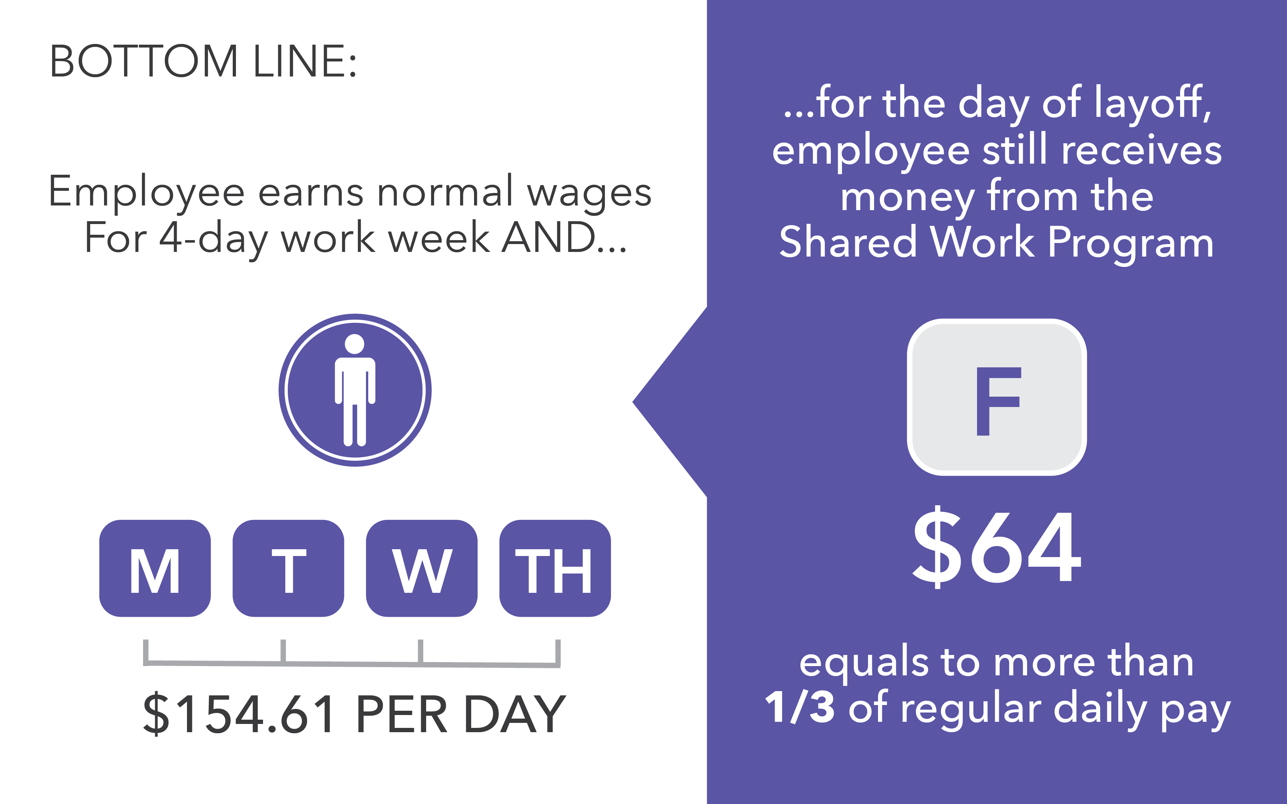
Notes:
Now under Shared Work an employee’s hours and pay can be cut between 20 and 40% but we’ll keep with our example of 20% here.
If an employee’s hours were cut 20%, here’s how it would work for them. The employee would not only continue to receive their benefits but they would receive 4 days of regular pay + 20% of their unemployment since their hours were cut 20%. Receiving 20% of their unemployment for the week equals roughly a third of the average person’s daily salary.
So getting your benefits and 4 and roughly a third of a day’s pay is not five days of pay but it’s a lot better than trying to live and budget on $320/week.
[Note: This would be an employee earning roughly $40,000 a year. His regular earnings for 4 days would be $618.46 + shared work of $64 for $682.46 vs regular $773.08. ($90.62 diff/short)]

Slide 14
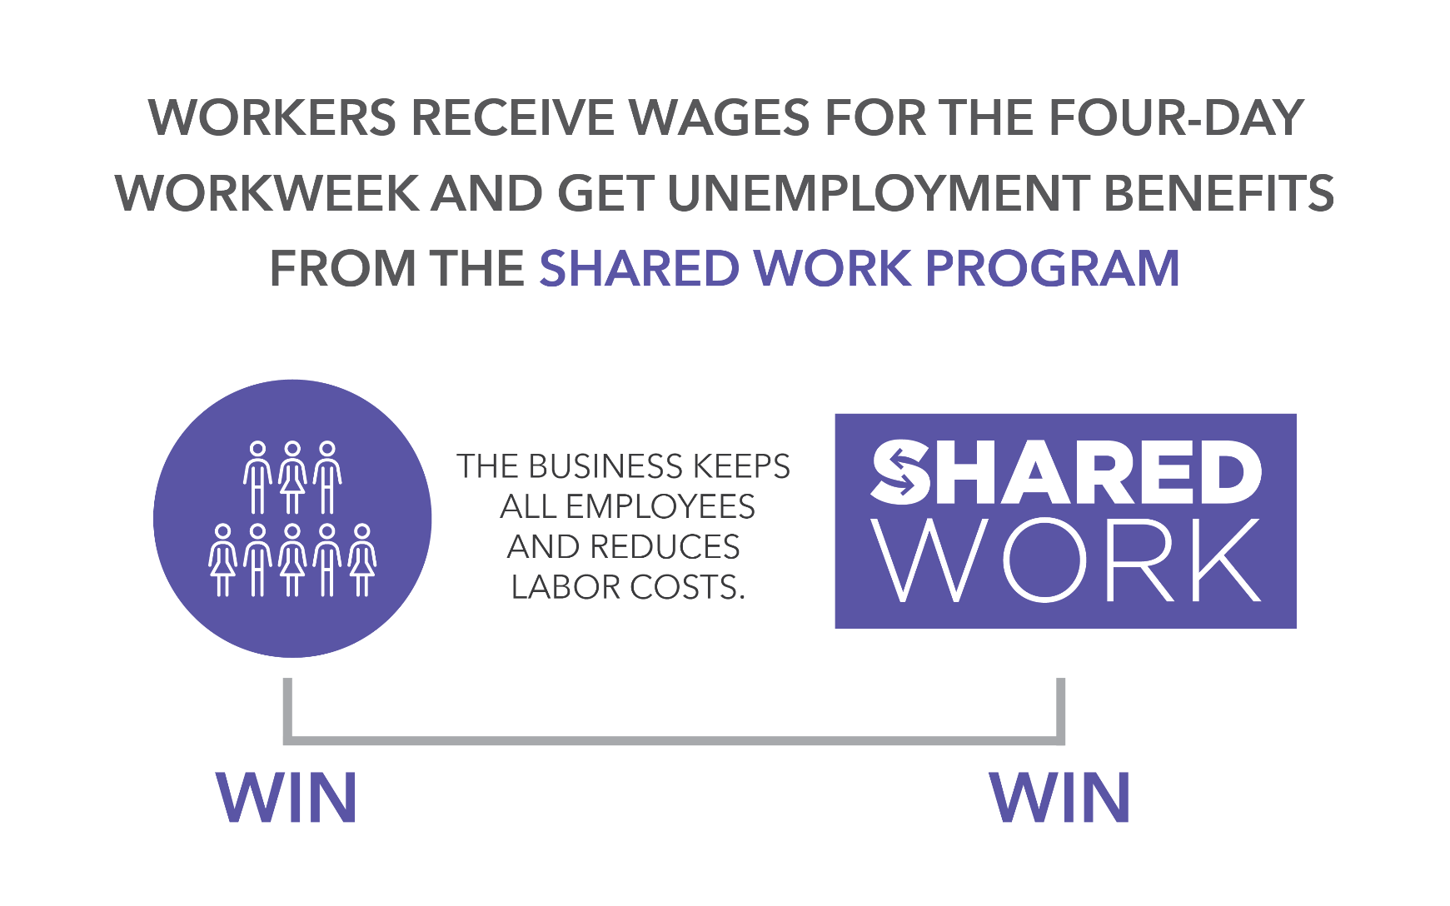
Notes:
keeping their benefits which is huge for the family, they are keeping up their skill sets, know what’s going on inside the company, and enjoying the camaraderie of co-workers. So as soon as work picks back up, the employer has a skilled, experienced workforce ready to come back to work! No need to recruit, hire and train new employees. And, being able to ramp up quickly keeps the employer competitive!
Additionally since employees are still working 3-4 days a week, they still feel connected and the employer demonstrates that they care about all of their employees. Now the employees AREN’T getting five days of pay, but it’s much easier to budget and live on 3-4 days pay and Shared Work then it would be to live on $320/week on unemployment!

Slide 15
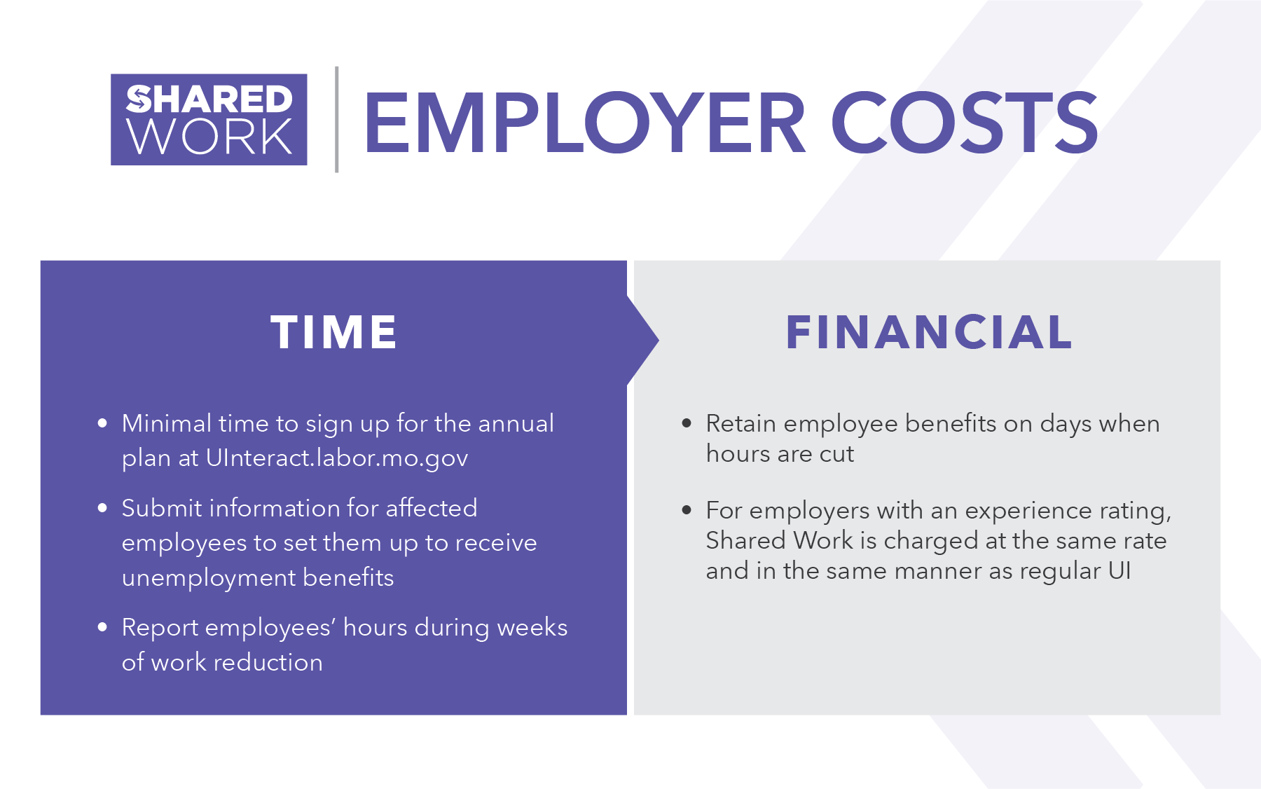

Slide 16
How Do Employers Benefit?
Retention of skilled workers
Reduction in labor costs
Saves money and time re-hiring
capable employees

Slide 17

How Do Employees Benefit?
Remain attached to the workforce
Continue to receive benefits
Receive a portion of UI benefits to offset wage reduction
Pride and morale

Slide 18

How Do Communities Benefit?
Money stays in the local economy
Retains a skilled workforce
Thriving communities are attractive to
new business

Slide 19
With Shared Work…
Higher employee retention (no additional hiring and training costs)
Higher productivity
Easier on employees’ budgets working 4 days
with Shared Work pay vs. total layoff
Efficiency with skilled employees vs. temps and ability to ramp back up quicker
Client retention/institutional knowledge

Slide 20
Effect on Employer’s UI Tax Rate
Shared Work UI benefits are charged back against the employer’s account for use in calculating (experience) tax rates. It affects an employer’s tax rate in the same manner and to the same extent as other charges for UI benefits.
If a business is unsure of it’s tax rate or is a new business who is not yet eligible for a tax rate, they should contact Employer Accounts for more information on how Shared Work may impact the business.
Employer Accounts: 573-751-1995

Slide 21
Additional UI Information
Employees must still serve a waiting week.
Employers may have more than one Shared Work plan covering multiple units.
Benefits are payable up to 52 weeks, but the total cannot exceed the maximum benefit amount.
Part-time employees are eligible for Shared Work.
Notes:
Here’s some additional information and answers to some frequently asked questions.
Employees will still have the waiting week.
Employer can have more than one plan covering multiple units. For example, if one company has multiple locations they can have separate plans.
Benefits can be paid up to 52 weeks, but cannot exceed the maximum benefit amount.
Part-time employees are also eligible for the program.

Slide 22
A Special Note about Layoffs:
An employer may utilize both Shared Work and temporary layoffs
If a business is enrolled in Shared Work and foresees a layoff, they should contact
their Shared Work specialist
before or during the layoff week

Slide 23


…
is effective
saves Missouri businesses money
provides 100% employee retention
is easy to enroll in, flexible, and takes minimal effort

Slide 24
FOR MORE INFORMATION:
Visit sharedwork.mo.gov
TO APPLY
Sign up at uinteract.labor.mo.gov
QUESTIONS
Call us at 573-751-WORK (9675)
Email us at shared.work@labor.mo.gov

